Slide 1
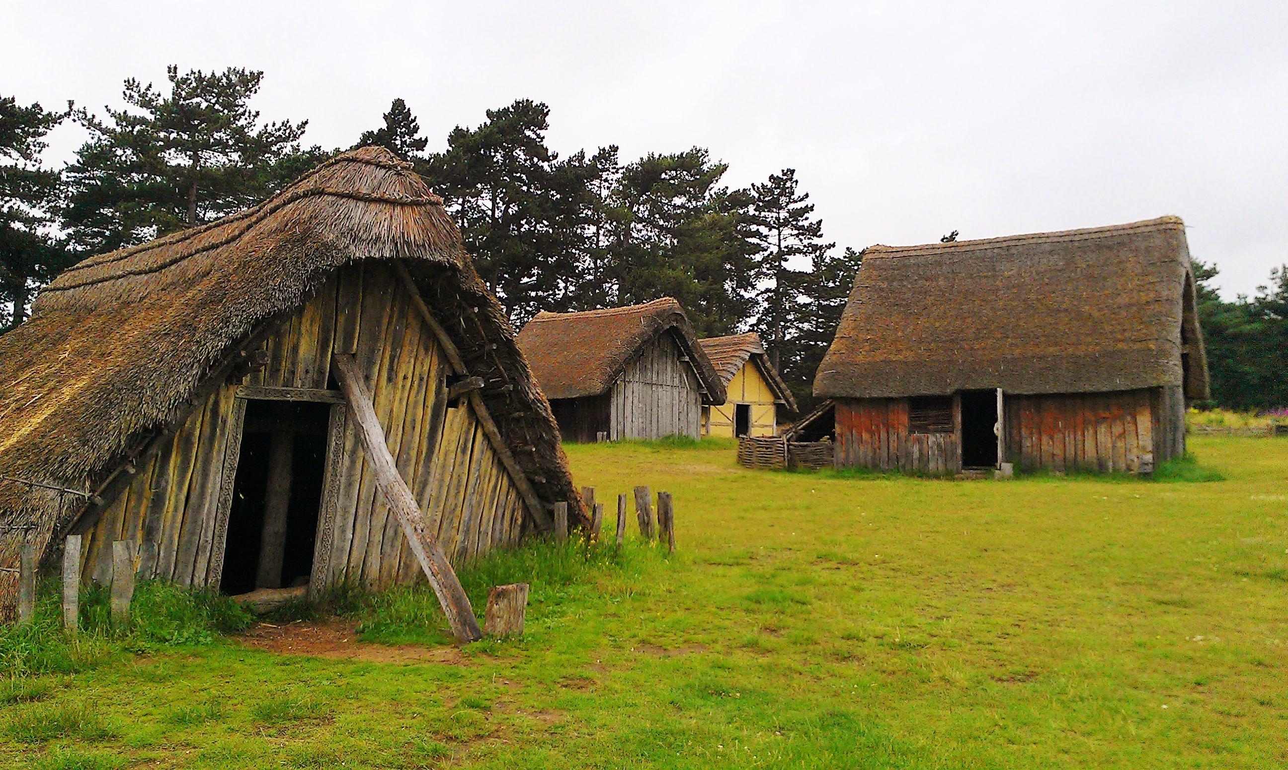
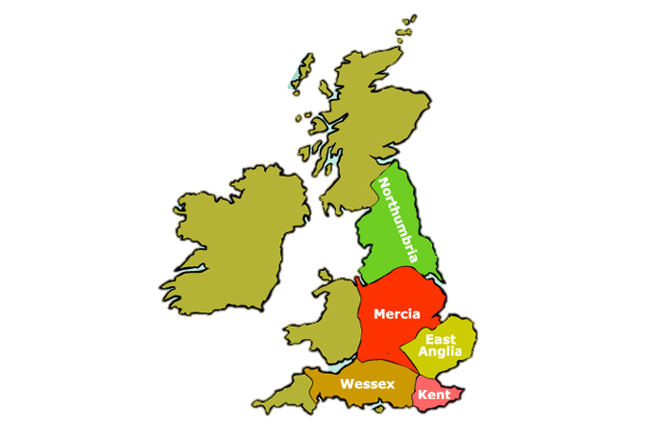


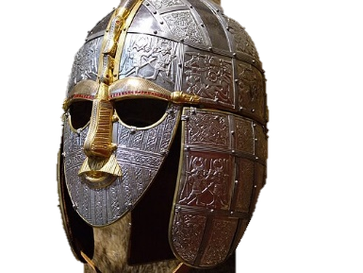
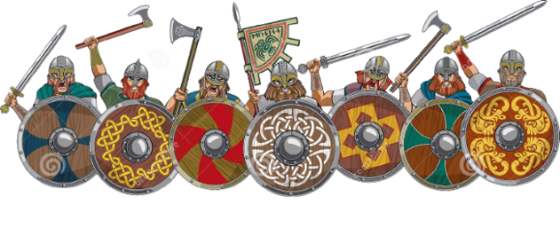
English
Understanding Science and Technology
Science: We will be looking at different states of matter to support our understanding of the water cycle and the world around us. We will conduct investigations and experiments to help us understand the different states of matter and changes that can occur.
DT: We will be exploring seasonal produce to plan a healthy savoury dish and explain where the ingredients came from.
Fiction: We will continue to learn how to
write a recount using our fantastically
magical text…
‘Leon and The Place Between’.
We will learn how to write a diary entry
while consolidating our new grammar skills.
We are learning how to use fronted adverbials and expanded noun phrases to create a mood in our writing.
In Guided Reading, we will be exploring the text
‘The Train to Impossible Places’ and using this to develop our comprehension and inference skills.
Year 4
Autumn Term 2
2024-25
Settling Saxons and
Scary Scots
Understanding the World
History: We will be learning all about the Anglo Saxons and Scots and how they both settled in Britain.
RE: We will be exploring the Trinity and Christmas and why they are so important to Christians.
Spanish: We will be learning all about shapes and colours in this half term.
Maths
Place Value: We will be learning about area of rectilinear shapes this term first and then beginning multiplication and division.
We will then move on to choosing the most efficient methods of problem solving.
Time tables are still a HUGE priority for us in Year 4 and we will continue with daily counting and multiplication sessions in addition to our maths lessons.
Understanding Arts and Culture
Art: We will be starting a textile project in Art and creating our very own Anglo Saxon emblem.
Music: We will learn some more Spanish songs and be creating our own pieces of music.
Understanding our Health and Well-Being
PE: We will be continuing with our weekly swimming lessons and playing basketball to consolidate our throwing and catching skills.
PSHCE: We will be learning about why it is important to celebrate difference.

Slide 2

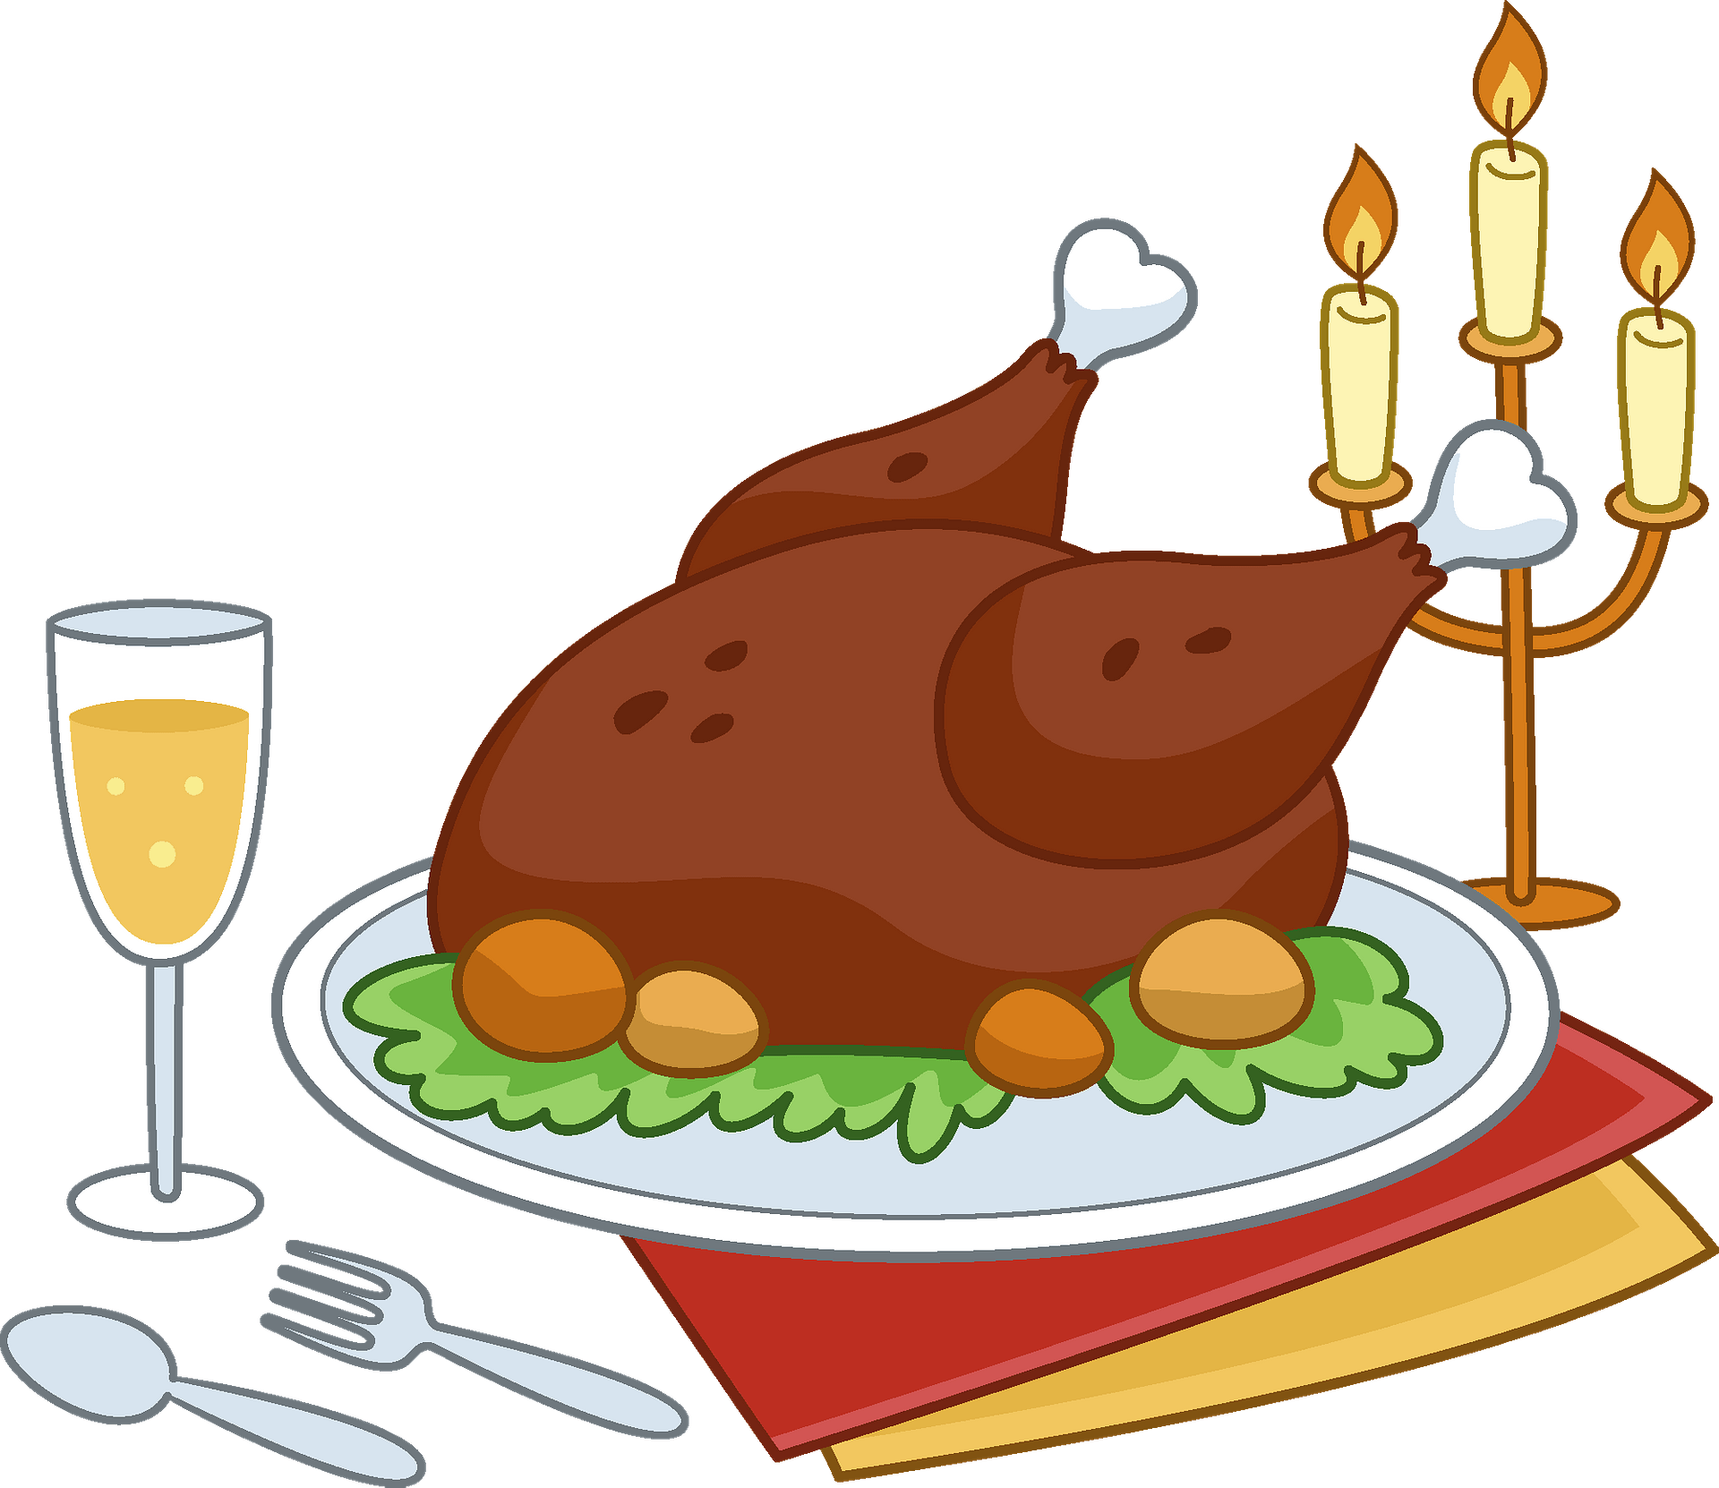


“Learn. Believe. Achieve.”
Our School Values: Resilient, Persistent, Self-Motivated, Risk-Takers, Creative, Good Citizens, Entrepreneurial
Dear Parents/Carers,
The second half of our Autumn term is upon us, and we are sure that it will fly by in a flurry of Remembrance
celebrations, non-uniform days, winter jumper designs and the delicious Christmas dinner day.
Please find overleaf details about what your child will be learning in class over this half-term. Weekly homework will be set in either homework books or via online learning platforms. We would encourage you to please spend some time at home each week practising the spellings and times tables we are working on in class. Please also read together with your child every day as it really does make such an enormous difference to their ability to read with fluency, confidence and understanding; reading records should be in bags daily.
Thank you for your continued support,
Mrs Bevan, Mrs Hares and Mrs Smith.

